Slide 1
Project AI:
Indoor Mobile 3D Scanning
JianHan Chen, Julian Schoep, Jarno Verhagen, YaChu Yang
Supervisor: Sezer Karaoglu

Slide 2
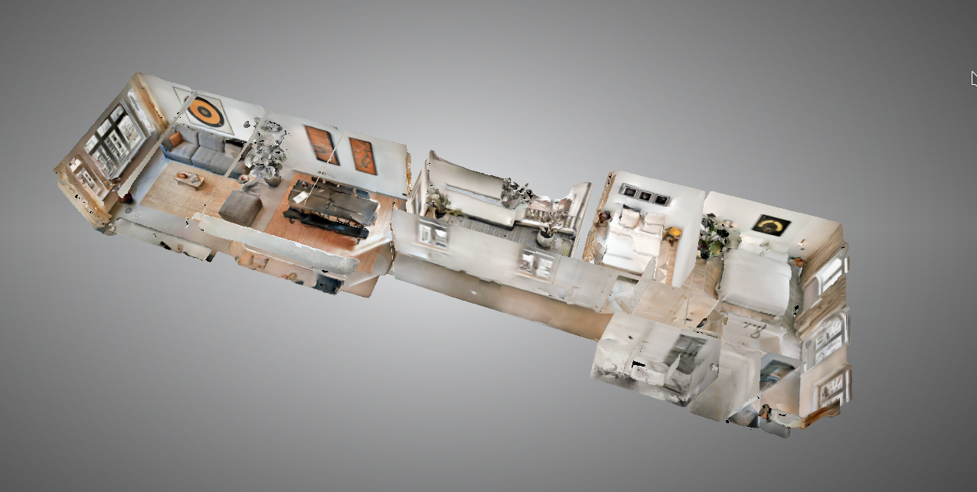
Goal: 3D Indoor Reconstruction
Scan environment with a phone (no depth information)
Construct 3D model
Real-time processing
Goal Related Work Pipeline Results Questions

Slide 3
Related Work
For an accurate 3D model you need accurate dense depth maps
Learning-based methods
Using deep learning model to generate estimated depth maps + Obtains dense depth map, which could lead better 3D reconstruction - Result is often not detailed enough
Optimization-based methods
OpenMVG, COLMAP, AliceVision
Use Structure from Motion (SFM)
Obtain features from frames (e.g. SIFT)
Use features trajectories over frames to calculate camera pose
Generating better 3D reconstruction result, but time-consuming
Goal Related Work Pipeline Results Questions
Notes:
Related work:
High level explain structure from motion, learning based (and a third one? Optimization based?)
Explain why we use hybrid (draw backs from previous methods)
Focus on problems! So you can reference these troughout presentation (maybe with visuals)
Optimization-based method: it seems like mainly doing optimization on sfm and mvs

Slide 4
Our Pipeline: a hybrid of SFM and Learning Based
Structure From Motion
Learning Based
Sparse
Depth Map
Dense
Depth Map
Sparse Depth Estimation
Sparse to
Dense
3D
Reconstruction
Monocular
images
3D Model
Goal Related Work Pipeline Results Questions
Notes:
We werent sure about that
Multi-view stereo sounds better to me, but not entirely sure either
We can call it Mutli-View Stereo? I am not sure about the exact definitions of these things anyway

Slide 5
Sparse Depth Estimation
Monocular
images
Track features over consecutive frames by feature matching
Estimate camera pose from matched features
Triangulate 3D points from feature matches and camera poses
Project 3D points on 2D image planes to get sparse depth map
Experimented with ARKit and ORB-SLAM2
Sparse Depth Estimation
Sparse
Depth Map
Sparse to
Dense
Dense
Depth Map
3D
Reconstruction
3D Model
Goal Related Work Pipeline Results Questions

Slide 6
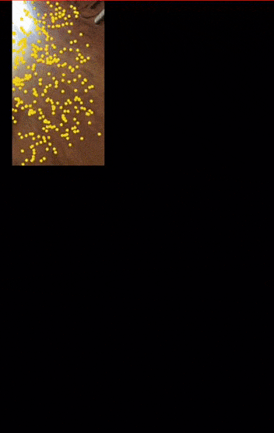
ARKit Point Cloud Construction
Monocular
images
Sparse Depth Estimation
Sparse
Depth Map
Sparse to
Dense
Dense
Depth Map
3D
Reconstruction
3D Model
Goal Related Work Pipeline Results Questions

Slide 7
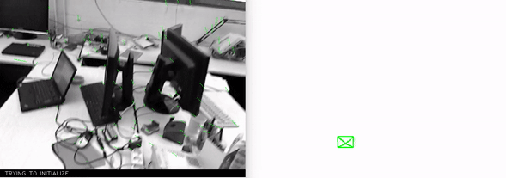
ORB-SLAM Point Cloud Construction
Monocular
images
Sparse Depth Estimation
Sparse
Depth Map
Sparse to
Dense
Dense
Depth Map
3D
Reconstruction
3D Model
Goal Related Work Pipeline Results Questions

Slide 8
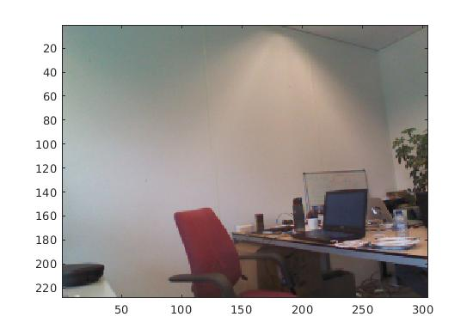
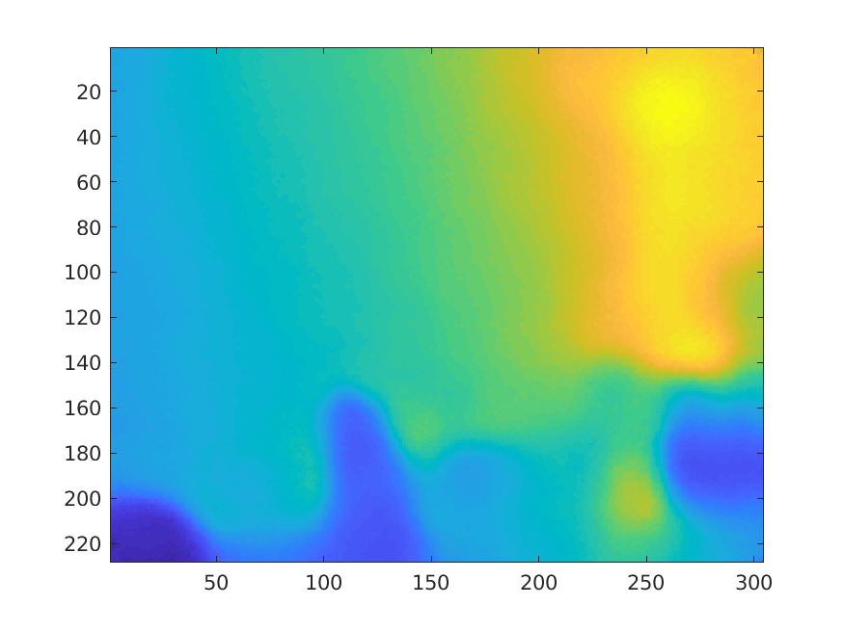
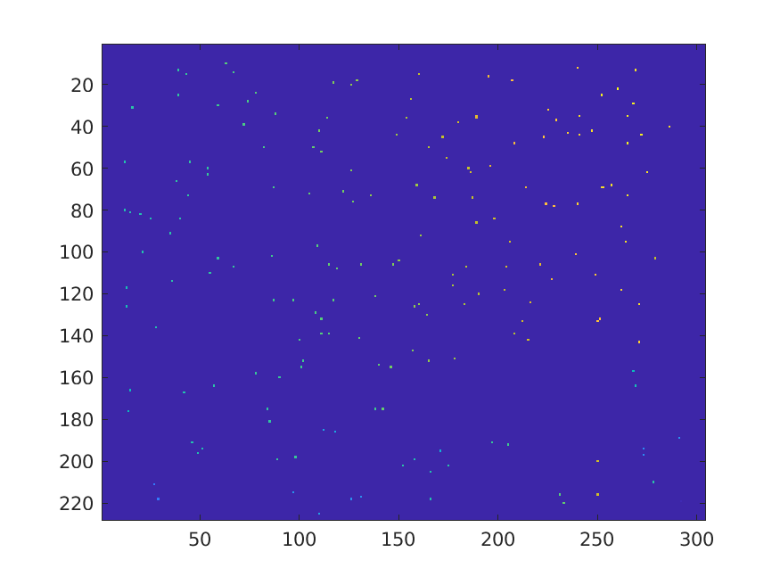
Sparse to Dense Network By Ma, F., & Karaman, S. (2017).
Monocular
images
RGB Image
Sparse Depth Estimation
Sparse
Depth Map
Sparse to
Dense
+
Dense
Depth Map
3D
Reconstruction
Dense Depth Map
3D Model
Sparse Depth Map
Goal Related Work Pipeline Results Questions
Notes:
Maybe don’t mention the papers but just high level what is done here?
And place the images somewhere nice :p

Slide 9
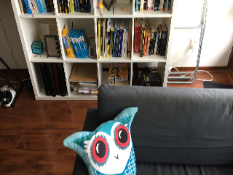
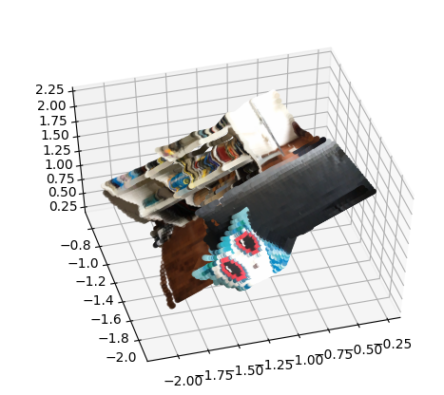
3D Reconstruction
Monocular
images
Pixel coordinate
Sparse Depth Estimation
Sparse
Depth Map
Sparse to
Dense
+
Dense
Depth Map
3D
Reconstruction
world coordinate
3D Model
Dense Depth Map
Goal Related Work Pipeline Results Questions
Notes:
Mention pretrained model

Slide 10
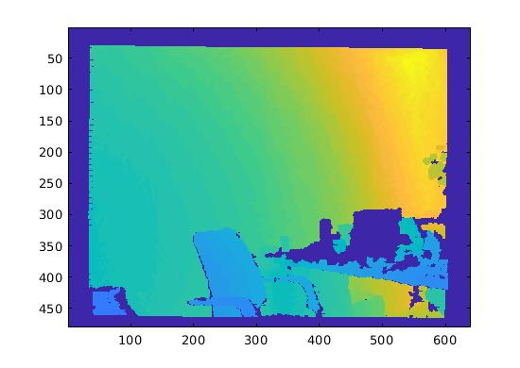
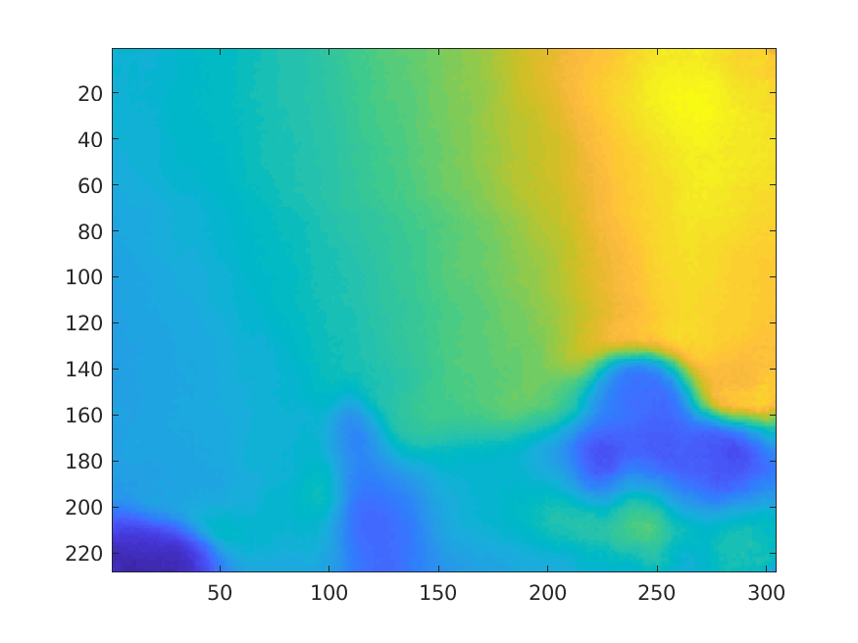
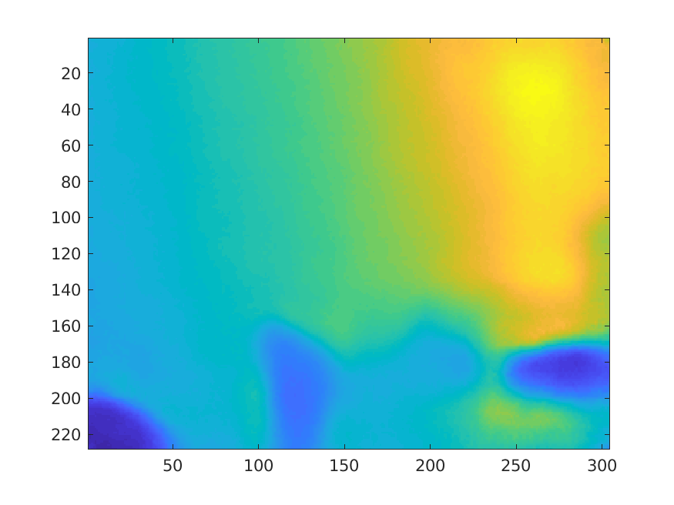
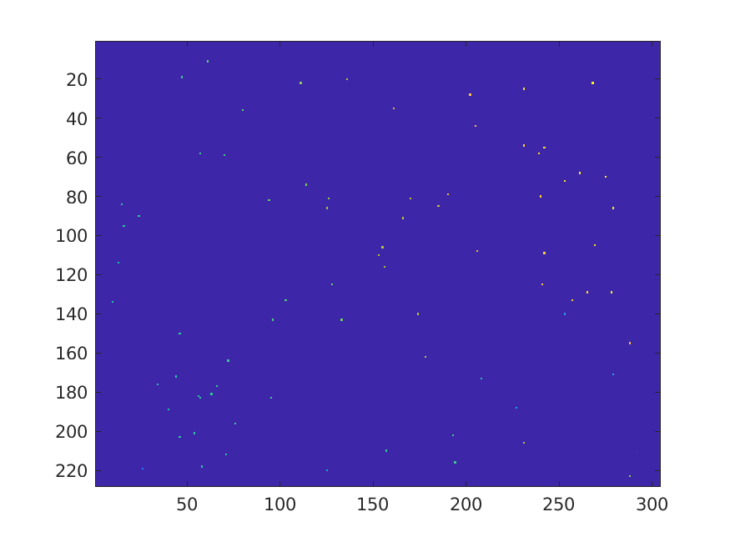
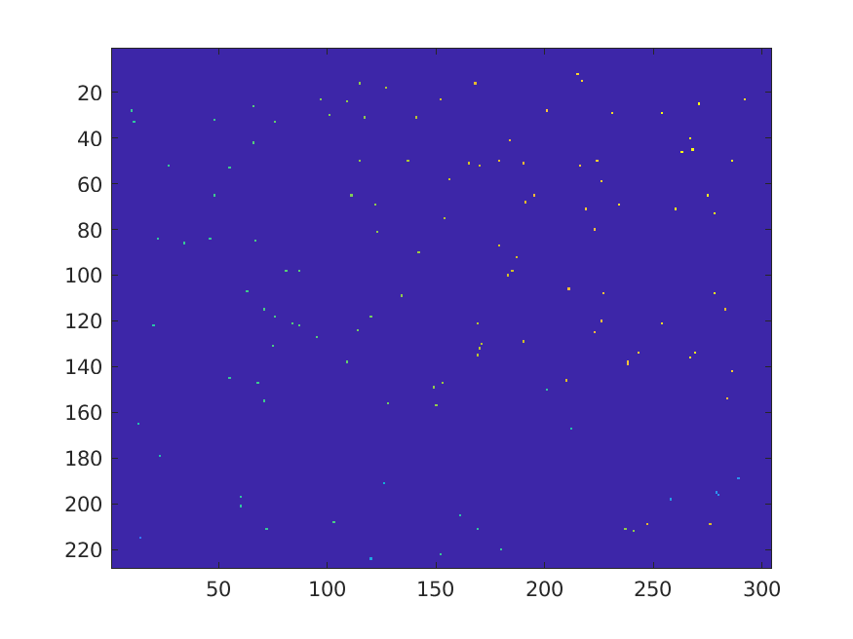
Experiment: Sparse to Dense (Test Data)
Are 100 features points good enough?
Ground truth
100 sparse
depths sample
150 sparse
depths sample
200 sparse
depths sample
Goal Related Work Pipeline Results Questions

Slide 11

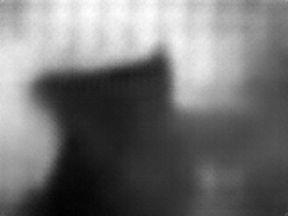
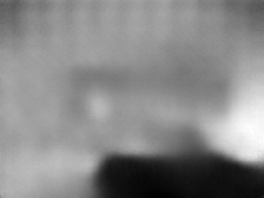
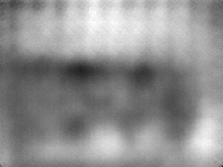
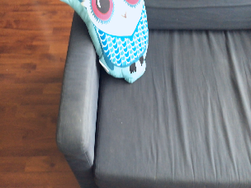
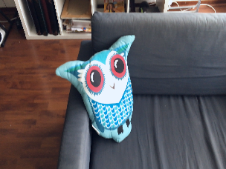
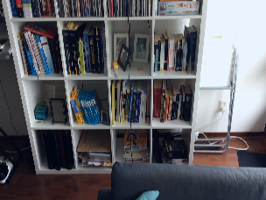
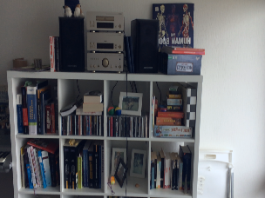
Result: Sparse to Dense (ARKit)
Goal Related Work Pipeline Results Questions
Notes:
put image with feature points

Slide 12
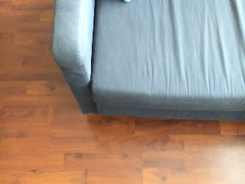
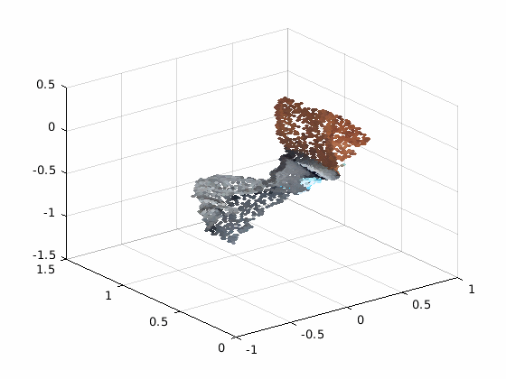
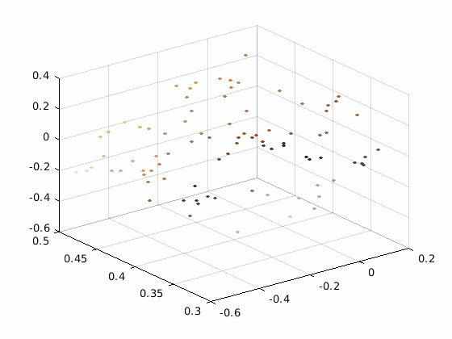
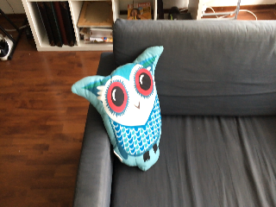
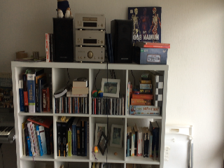
Result: 3D Reconstruction
Goal Related Work Pipeline Results Questions

Slide 13
Experiment: Add more feature points
Adjacent
Frames
0
2
4
Goal Related Work Pipeline Results Questions

Slide 14
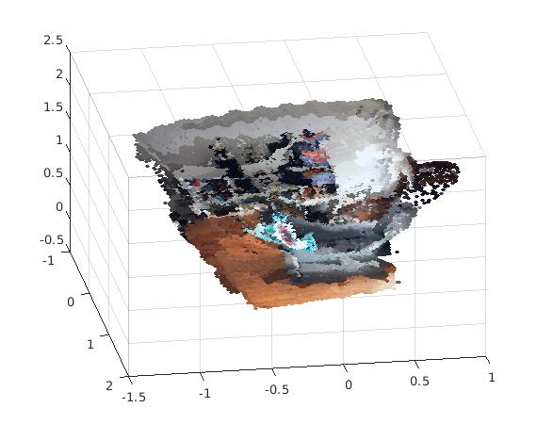
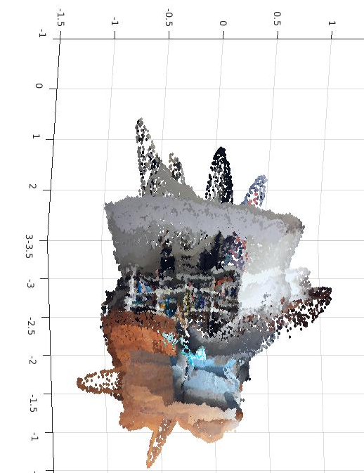
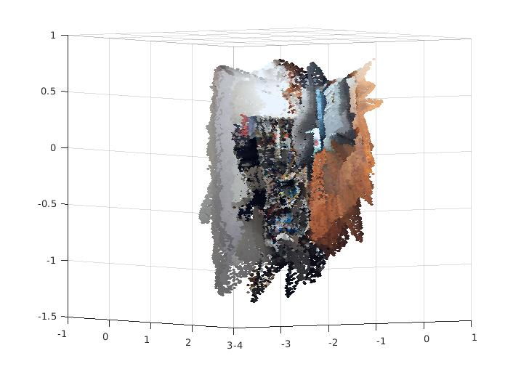
Result: 3D Reconstruction with Adjacent Frames
Adjacent
Frames
0
5
10
Features Per Frame (average)
122
156
182
Goal Related Work Pipeline Results Questions

Slide 15
Conclusion
Results look promising, but work needs to be done to make it into a product.
Many parts in the pipeline are based on predictions, and optimizing might improve performance
Goal Related Work Pipeline Results Questions

Slide 16
Future Work
Real time processing
Make s2d work on device
New depth estimation methods (PlaneNet)
Goal Related Work Pipeline Results Questions

Slide 17
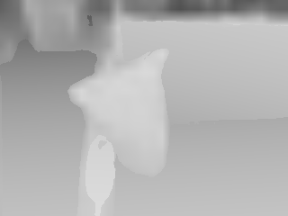

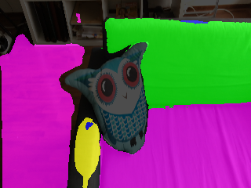
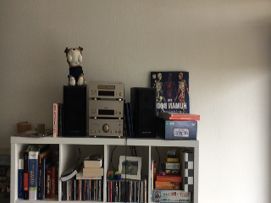


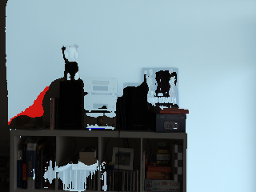
Future Work: PlaneNet
Input: RGB
Output: Depth, Segmentation
Goal Related Work Pipeline Results Questions

Slide 18
Thank you for your attention
Goal Related Work Pipeline Results Questions

Slide 19
Goal: 3D Indoor Reconstruction
Scan environment with a regular phone camera
Construct 3D model from indoor scene
Of high value to companies such as Airbnb and Ikea if processed in real-time
Goal Related Work Pipeline Results Questions

Slide 20
Related Work
RGB based methods
Structure from motion
Stereo based methods
RGB-based depth prediction
D. Eigen, C. Puhrsch, and R. Fergus, “Depth map prediction from a single image using a multi-scale deep network,” in Advances in neural information processing systems, 2014
Depth reconstruction from sparse samples
S. Hawe, M. Kleinsteuber, and K. Diepold, “Dense disparity maps from sparse disparity measurements,” in Computer Vision (ICCV), 2011 IEEE International Conference on. IEEE, 2011
Goal Related Work Pipeline Results Questions
Notes:
only list the works using nerual network to estimate depth (maybe more related work?)
Have short description on each work

Slide 21
3D Reconstruction
Monocular
images
u
Sparse Depth Estimation
v
Sparse
Depth Map
Sparse to
Dense
Dense
Depth Map
Pixel coordinate
3D
Reconstruction
World coordinate
Intrinsics and extrinsics
3D Model
Goal Related Work Pipeline Results Questions
Notes:
picutrcitation

Slide 22
Sparse Depth Estimation
Monocular
images
Keypoint features are detected in monocular images
Features are matched over consecutive frames
Based on feature correspondences the camera pose is estimated
With feature correspondences and camera pose, 3D points can be triangulated
3D points visible in a given frame are projected back onto the image plane to get a sparse depth map per frame
Sparse Depth Estimation
Sparse
Depth Map
Sparse to
Dense
Dense
Depth Map
3D
Reconstruction
3D Model
Goal Related Work Pipeline Results Questions

Slide 23
Experiment: Add more feature points
Adjacent
Frames
0
9
Features Per Frame (average)
122
156
182
Goal Related Work Pipeline Results Questions

Slide 24
Result: 3D Reconstruction
Front view
Full view
Side view
Goal Related Work Pipeline Results Questions

Slide 25
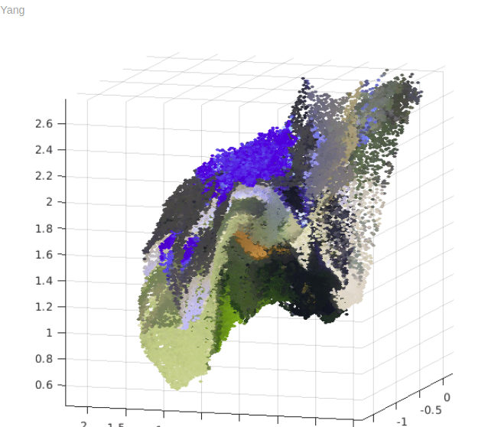
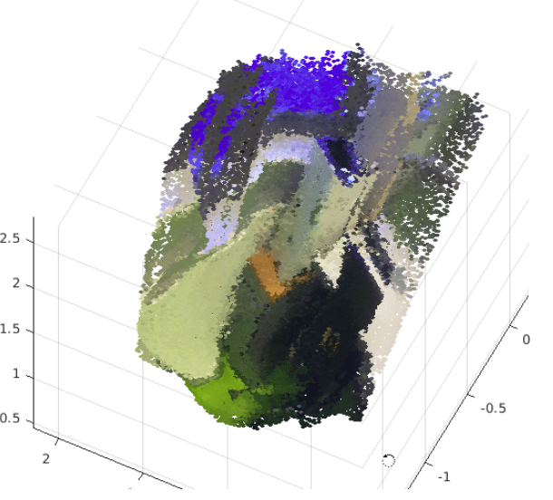
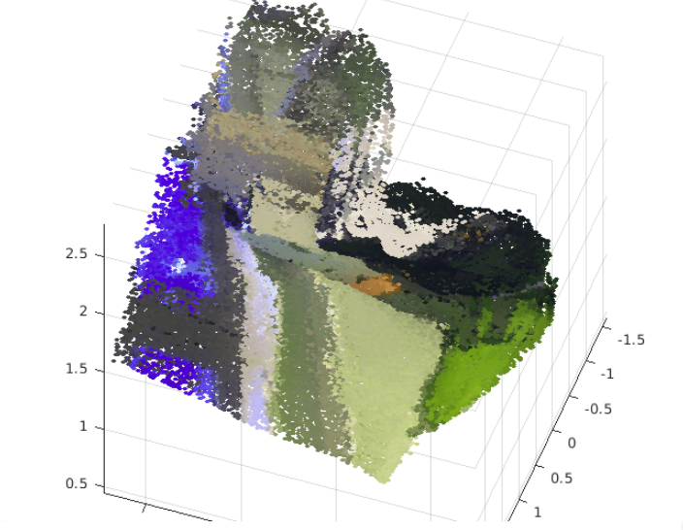

Slide 26
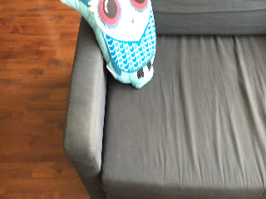
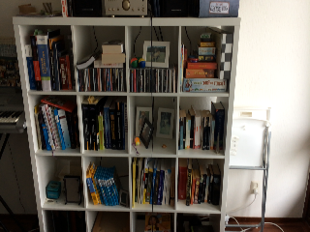

Slide 27
